Slide 1
Knowledge Base Completion via Search-Based Question Answering
Robert West, Evgeniy Gabrilovich, Kevin Murphy, Shaohua Sun, Rahul Gupta , Dekang Lin
Computer Science Department, Stanford University, Stanford, CA
By
Ayoub,Ronald Naim
Maddula,Manikanta

Slide 2
The Need for KB Completion
Despite the wealth of information available in knowledge bases, they are incomplete.
The chart to the right shows the percentage of PERSON individuals without a given PROPERTY in Freebase, both for the 3 million total PERSON entities and for the top 100,000 most searched entities. For instance, 68% of PERSON entities in all of Freebase do not have the PROFESSION property assigned.
The problem is more pronounced when considering the most frequently searched entities.

Slide 3
Approaches to KB Completion
Push
Pull
Traditional approaches process documents in batches using NLP to extract RDF triples and then pushes them to the KB. This approach is not targeted.
The authors propose a new approach in which specific questions are asked against existing web resources and that information is then pulled into the KB. This approach is targeted.
batch
web
KB
KB

Slide 4
What questions do we ask?
?
Question: “Who is Frank Zappa’s Mother”
Most Likely Answer: “The Mothers of Invention”
In most search engines the top result will be “The Mothers of Invention”, the name of Frank Zappa’s band. We need to augment the original query with disambiguating words. But with what words? As their primary motivation, the authors’ seek to answer this question.
BUT THEY ARE BOUND BY THE FOLLOWING CONSTRAINT:
If you ask too many questions you increase the risk of false positives – decreased precision. If you ask too few, you increase the risk of not finding the answer – decreased recall.

Slide 5
Open and Closed Classes
?
When it comes to balancing precision vs. recall the authors’ distinguish the following two types of classes of individuals:
Open Class: a class having a large number of individuals (not quite unbounded but close)
Closed Class: a class having a limited number of individuals (having a reasonable bound)
For an Open Class the risk of false positives is greater since there are more individuals that can possibly be returned in the results of a query. For a Closed Class the risk of false positives is lower proportional to the number of individuals in the class and therefore we can safely ask more questions.

Slide 6
Knowledge Base Completion Pipeline
Query Template Selection
Set of selected queries
Question Answering
Set of ranked answers per query.
Answer Resolution
Set of ranked answers per query.
Answer Aggregation
Aggregated ranked answers
Answer Calibration
Probabilistic predictions
Raw Text
Entities
Questions are asked against the Freebase KB. The authors illustrate this for the question:
“Who is Frank Zappa’s Mother?”

Slide 7
Query Template Selection
Query Template Selection
Set of selected queries
Query templates are mined from existing Freebase search logs.
Original query: “parents of Frank Zappa”
Subject determination: “parents of [Frank Zappa]”
Relation determination: “[PARENTS] [Frank Zappa]”
Using the above terminations, templates are lexicalized.
Lexicalized template: “parents of _”
Based on frequency and quality, a subset of the templates corresponding to a given relation are selected as the KB completion queries. The class of the subject is used to determine the size of this subset. Open classes result in fewer queries selected whereas it is safe to ask more questions for closed classes.

Slide 8
Question Answering
Question Answering
Set of ranked answers per query.
Once query templates have been determined for a given completion task, queries are submitted to Freebase via a proprietary QA system. Multiple queries may be submitted for a single completion task. For instance, for the task of determining Frank Zappa’s parents, the following queries may be submitted:
Frank Zappa mother
Frank Zappa mother Baltimore
parents of Frank Zappa
Notice the word “Baltimore” in the second query. “Baltimore” is a disambiguating query term. The authors refer to this as query augmentation as previously mentioned.

Slide 9
Answer Resolution
Answer Resolution
Set of ranked answers per query.
The results of the proceeding queries will be unstructured text. Similar to the use of the word “Resolution” in Named Entity Resolution, here resolution refers to linking the components of the unstructured query results to entities, i.e. subjects, relations and objects.
As an example, if the word “Gail” is referred to in result text it can have multiple possible meanings:
Gail – a river in Austria
Gail – as in Gail Zappa, Frank Zappa’s wife (at least for a brief moment)
The second option would be chosen in the context of a query task about Frank Zappa.

Slide 10
Answer Aggregation
Answer Calibration
Probabilistic predictions
Since multiple queries are submitted for each completion task, there will be multiple ranked result sets to deal with. Typically, results are ranked according to relevance. Relevance is not a probability of relevance and can only be used for comparisons relative to a result set. For instance, how would the following results be combined for queries q₁ and q₂.
q1 – r₁₁, r₁₂, r₁₃, r₁₄, r₁₅
q2 – r₂₁, r₂₂, r₂₃, r₂₄, r₂₅, r₂₆, r₂₇
The authors’ approach to this problem is to combine the relevance scores based on averaging across all query result sets.
Averaging is usually done against magnitudes having equal units. I believe there are better approaches to combining relevance scores.

Slide 11
Answer Calibration
Answer Calibration
Probabilistic predictions
Answer aggregation results in a single combined result set:
q2 – r₂₁, r₂₂, r₂₃, r₂₄, r₂₅, r₂₆, r₂₇
These scores are still relevance scores, which are hard to reason about. Therefore, these scores are converted into probabilities using logistic regression. In all cases, the highest ranked answer is chosen as the answer for knowledge completion, but only if it crosses a configured probability threshold.
At this point the answer is pushed into the KB and the completion task is complete.

Slide 12
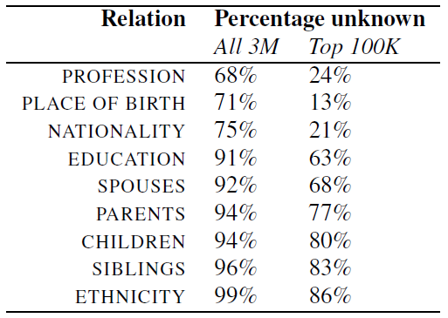

Empirical Evaluation
Training and Testing Data:
S -> R -> O all known.
100,000 most frequently searched-for persons.
Stratified Sampling Procedure:
The training sets TR
Test sets for each R
1000 subjects per relation, divided into 100 percentiles-randomly sample 10 subjects per percentile.
Ranking Metrics: (to quantify performance)
Mean Reciprocal Rank (MRR):
r1,r2,r3..rn -> ranks of elements of O.
The reciprocal of MRR is harmonic mean rank of highest-ranked true answers
Mean average Precision (MAP):
Averaging over several rankings yields the mean average precision.

Slide 13
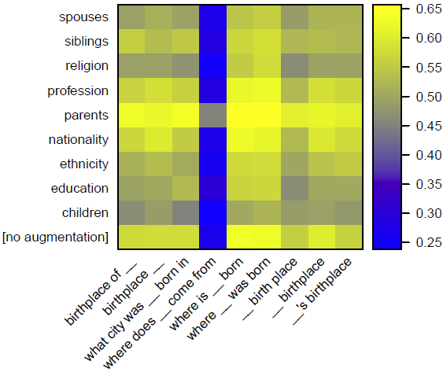
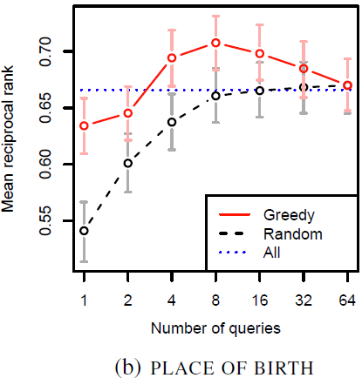
Quality of Answer Rankings
Sub selecting queries for aggregation:
Query selection is based on heat maps -> no. of queries -> greediness.
Red: Greedily selecting query templates that perform best.
Dashed Black: Selecting queries uniformly at random.
Dotted Blue: Selecting all queries.
Greedy is Best: works best for all relations
Asking too many questions can hurt (especially for open type)-false positives
Open Relations: Spouses, siblings, children etc. – inverted U shape greedy curve
Closed Relations: Nationality, Ethnicity etc. – diminishing returns curve.

Slide 14
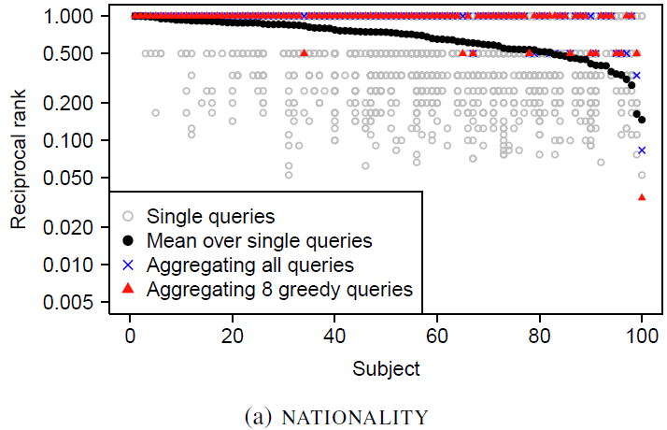
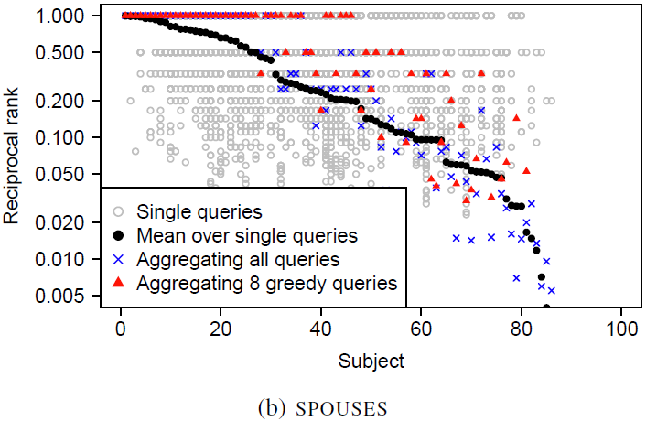
Quality of Answer Rankings
Subject Level Analysis:
One gray circle per query
Black dots: per subject MRR- column wise averages
Blue Crosses: RR aggregating over all queries per subject
Red Triangles: RR over 8 greedily chosen queries
Closed-MRR-0.94
Open-MRR-0.54

Slide 15
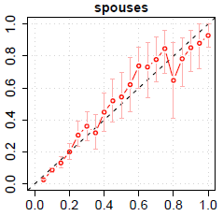
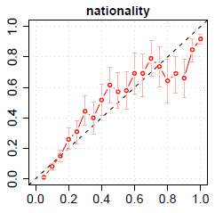
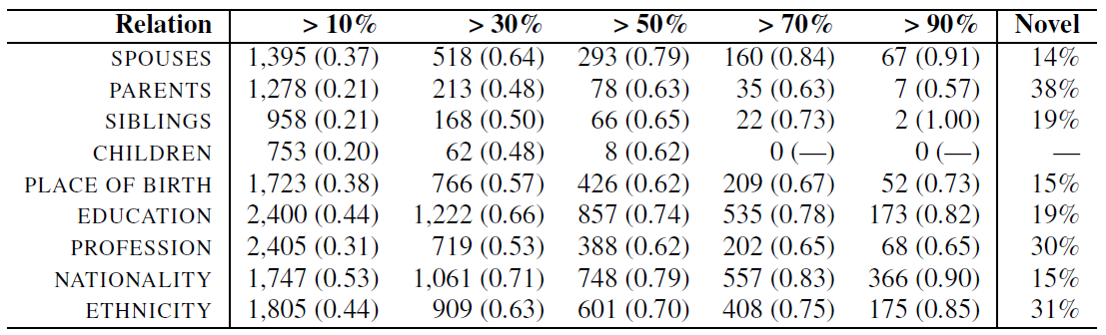
Quality of Calibrated Predictions
Evaluation of confidence score given by pipeline.
Run full pipeline using greedy selection-one agg. ranking per subject
X-axis: Predicted probability in 20 buckets (each 5%)
Y-axis: Fraction of true answers in each bucket
Number of High quality answers:

Slide 16
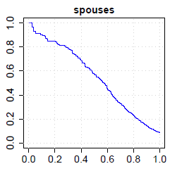
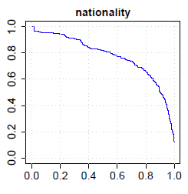
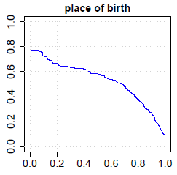
Quality of Calibrated Predictions
Precision and Recall:
X-axis: Recall and Y-axis: Precision
Curves plotted for single ranking per relation
Curve for Nationality looks best since its closed relation and achieves-
-higher MRR and MAP
Place-of-birth is more concave than Spouses

Slide 17
Discussion
Query Construction: add co-occurring phrases for augmentation. Disambiguate between entities with similar names.
Query Selection: sequential rather than a batch paradigm, asking one query at a time
Question Answering: SPOUSES performed better than CHILDREN. Treating QA system as Black Box
Answer Calibration: World knowledge into calibration (already available FREEBASE data)
Head vs tail: Freebase is less complete for unpopular than popular entities.
Fundamental limits to any automated methods: Find parents of ROSE MARIE COLIMORE. Having it verified by human users is also difficult task.

Slide 18
Conclusion
Presents a method for filling gaps in a knowledge base.
Uses a question-answering system, which in turn takes advantage of mature Web-search technology to retrieve relevant and up-to-date text passages to extract answer candidates from.
Show empirically that choosing the right queries—without choosing too many—is crucial.
For several relations, the presented system makes a large number of high-confidence predictions.

Slide 19

Questions?

